Slide 1


“STEP DETECTION & AUTOMATIC BREAK INTERLOCK SYSTEM”
PRESENTED BY:
KAVIARASU. R
MUTHUSAMY.M
VASANTHAKUMAR. G
GUIDEED BY:
MRS.P.KOKULASANDHIYA

Slide 2

“INTRODUCTION”
Every year, many accidents occur while passengers are getting on or off buses and other public transport vehicles. One common reason is that the vehicle starts moving before the entry step or footboard is safely retracted. This can lead to serious injuries and even loss of life. To overcome this problem, we propose a Step Detection and Automatic Brake Interlock System, which ensures that the vehicle cannot move unless the step is fully closed. The main objective of this system is to improve passenger safety using simple sensors and automatic control.

Slide 3

“Objectives”
Prevent bus movement while passengers are on the steps
Improve passenger safety.
Reduce accidents during boarding and alighting.
Develop a low-cost prototype using Arduino.
Design a smart passenger safety system for public buses.
Reduce accidents caused by premature bus movement

Slide 4
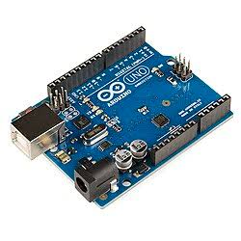
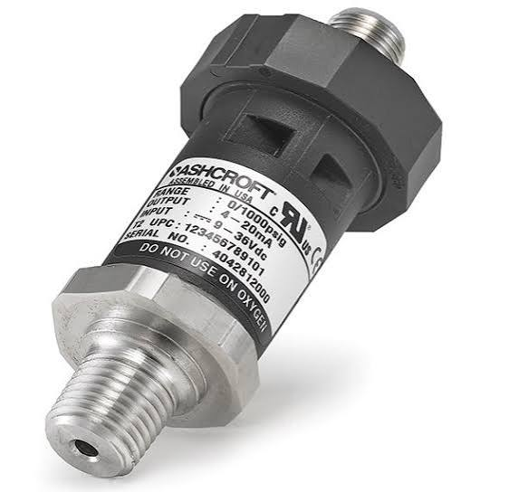
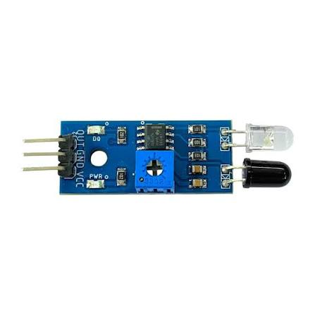
“Components”
Arduino Uno
IR Sensor
Pressure Sensor (FSR)
Relay Module
DC Motor
Buzzer
16×2 LCD Display
Power Supply
Connecting Wires

Slide 5

“working principle ”
The IR and pressure sensors detect a passenger on the bus step.
Arduino processes the sensor signals.
If a passenger is detected, the relay keeps the
brake engaged (or stops the motor in the
prototype).
The buzzer sounds and the LCD displays a
warning message.
After the passenger has boarded or exited and
the step is clear, the relay releases and the bus
can move.

Slide 6
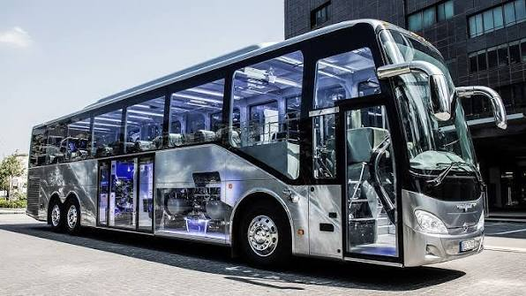
“OPERATION”
Passenger on step → IR sensor and pressure sensor detect occupancy.
Arduino receives the signals.
Relay remains energized to keep the brake engaged (or stop the prototype motor).
LCD displays "Passenger on Step".
Buzzer alerts the driver.
When the step is clear, the Arduino deactivates the relay and the bus can move.

Slide 7

“Advantages”
OUR SYSTEM PROVIDES SEVERAL ADVANTAGES:
IMPROVES PASSENGER SAFETY.
PREVENTS ACCIDENTS CAUSED BY AN OPEN STEP.
REDUCES DEPENDENCE ON HUMAN JUDGMENT.
LOW-COST AND EASY TO IMPLEMENT.

Slide 8

“Applications”
This system can be used in:
Public buses School buses Tourist buses
Ambulances Passenger vans Industrial
transport vehicles It can also be integrated
into modern smart transportation systems.

Slide 9
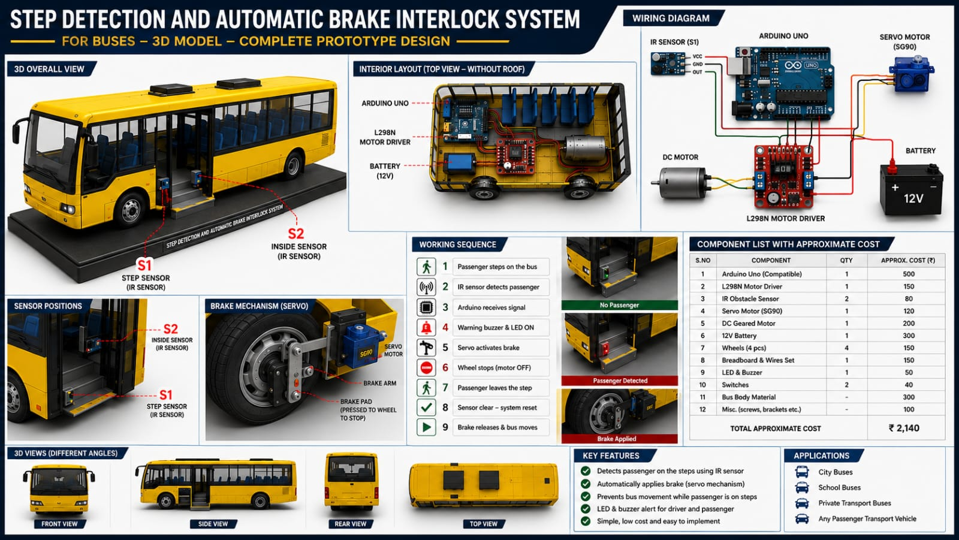

Slide 10

“ futuer scope”
this project can be improved by:
Adding Iot for real-time monitoring.
Using GPS to send alerts to transport authorities
Integrating AI-based safety monitoring.
Using industrial-grade sensors for improved reliability.
Connecting the system with the vehicle's ECU for advanced control.
These improvements will make the system more intelligent and suitable for commercial vehicles.

Slide 11

To conclude, the Step Detection and Automatic Brake Interlock System is an effective safety solution for passenger vehicles.
By combining sensors, a microcontroller, and an automatic brake interlock, the system ensures that the vehicle moves only when the step is safely closed.
This reduces accidents, improves passenger safety, and supports safer public transportation.
Thank you for your valuable time and attention.

Slide 12
THANK YOU SO MUCH!
thank you so much

